Slide 1


Machine Learning Using Google Cloud Platform
Project Supervisor: Dr. V. Maria Anu
Name of the Student: Dhaneshwar. V
Register Number: 39120022

Slide 2

Presentation Outline
Course Certificate
Introduction
Objectives
System Architecture / Ideation Map
Module Implementation
Application Snapshots
Results and Discussions
Conclusion & Future work
References
This Photo by Unknown author is licensed under CC BY-SA-NC.

Slide 3
Course Certificate
Certificate InProgress

Slide 4
Introduction
AI Platform enables many parts of the machine learning (ML) workflow. This document provides an introductory description of the overall ML process and explains where each AI Platform service fits into the process.
Machine Intelligence made easy: Vision/Speech API, TensorFlow ,Prediction Cases and Cloud ML
Reduce Ideation Spam, Transaction fraudulent ,&Image Coloriser and soon
Google Cloud Platform (GCP) is aiming to ease data engineering tasks for enterprises with the release of new tools and features that support the development of advanced machine learning applications and provide cross-cloud analytics capabilities

Slide 5
Objective and What we’ll cover
What is Neural Network and Deep Learning?
Machine Intelligence at Google Scale Cloud Vision API and Speech API TensorFlow and Cloud Machine Learning

Slide 6
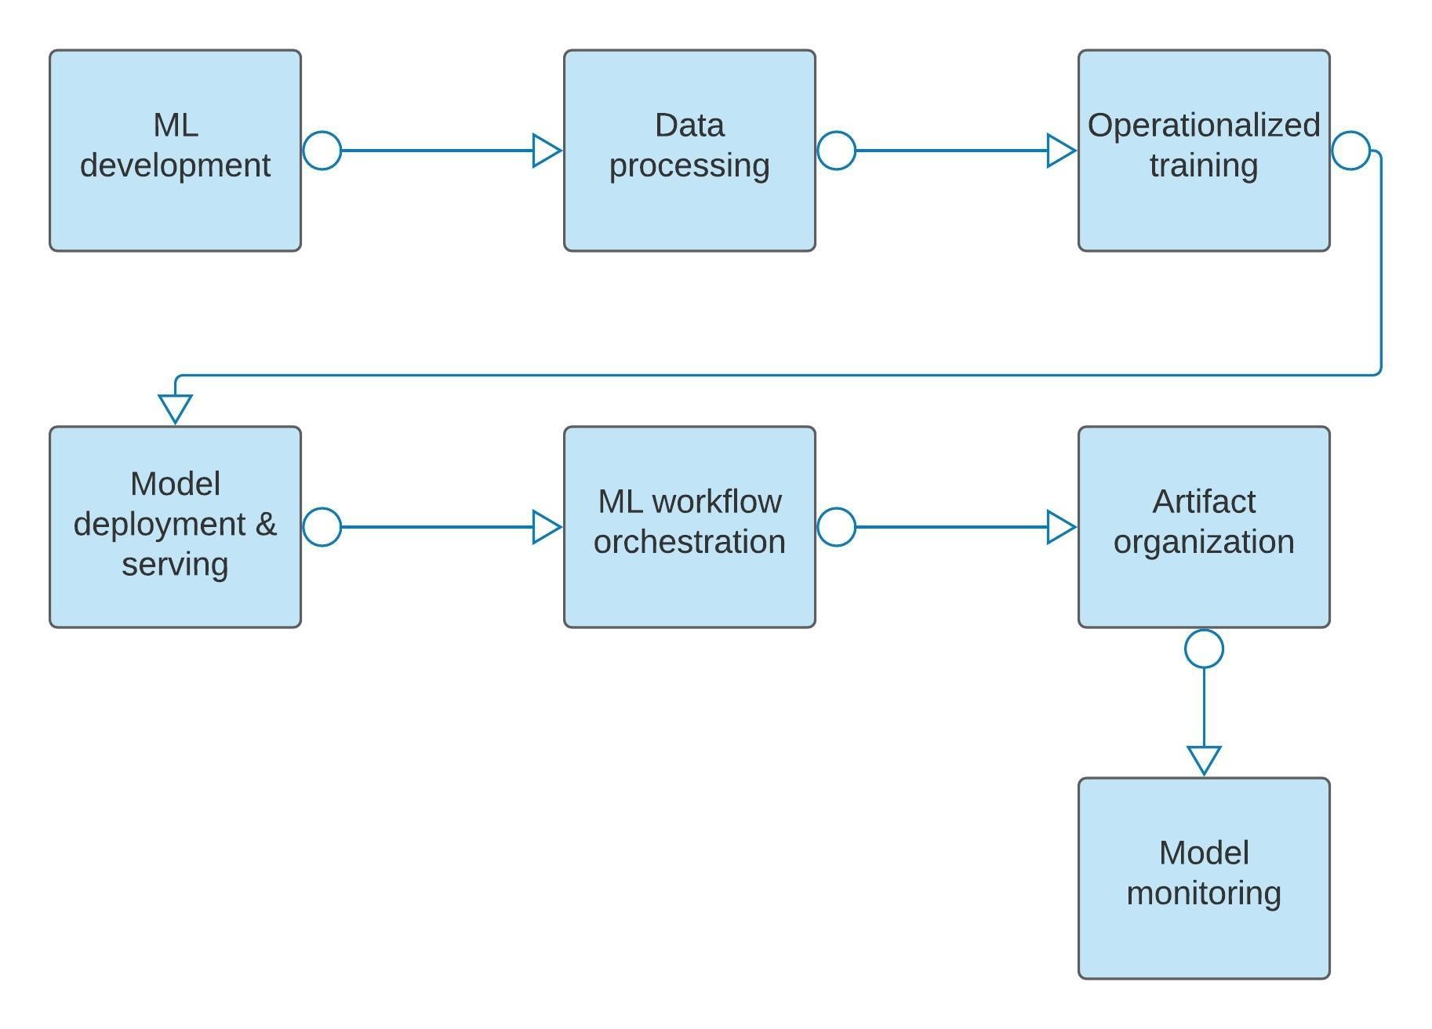
System Architecture / Ideation Map

Slide 7




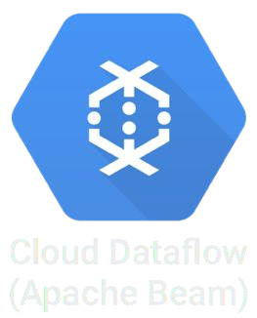







Ready to use Machine Learning models
Use your own data to train models
Alpha
GA
Alpha
Cloud Machine Learning
Cloud Vision API
Cloud Speech API
GA
GA
Beta
GA
Cloud Storage
Google BigQuery
Cloud Datalab
Cloud Translate API
Stay Tuned….
Develop - Model - Test
NEW

Slide 8
What is Neural Network and Deep Learning?

Slide 9
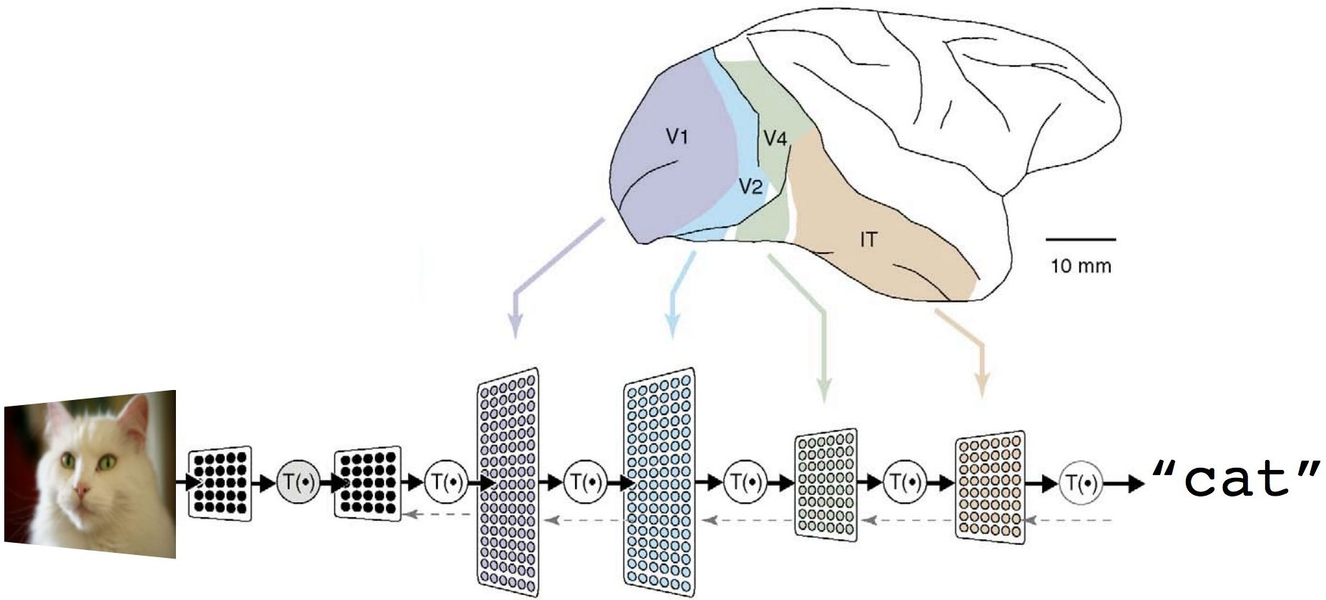
Neural Network is a function that can learn

Slide 10
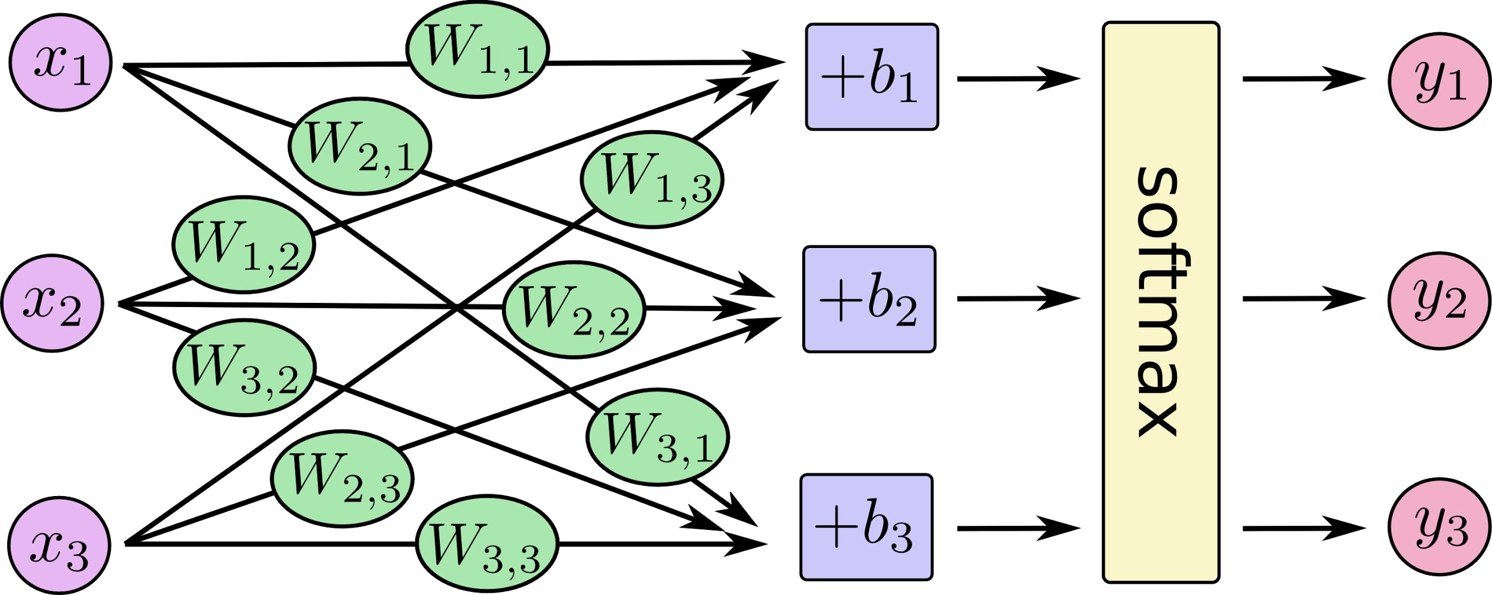
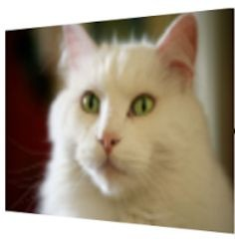
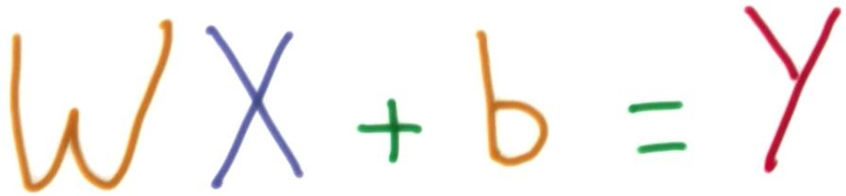
Mimics neurons with matrix operations
input vector (pixel data)
output vector (probability)
0.88 (cat)
0.12 (dog)
0.01 (car)

Slide 11
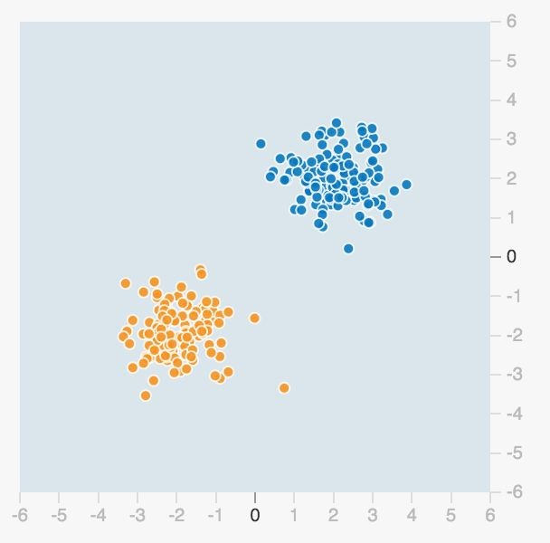
How do you classify them?

Slide 12
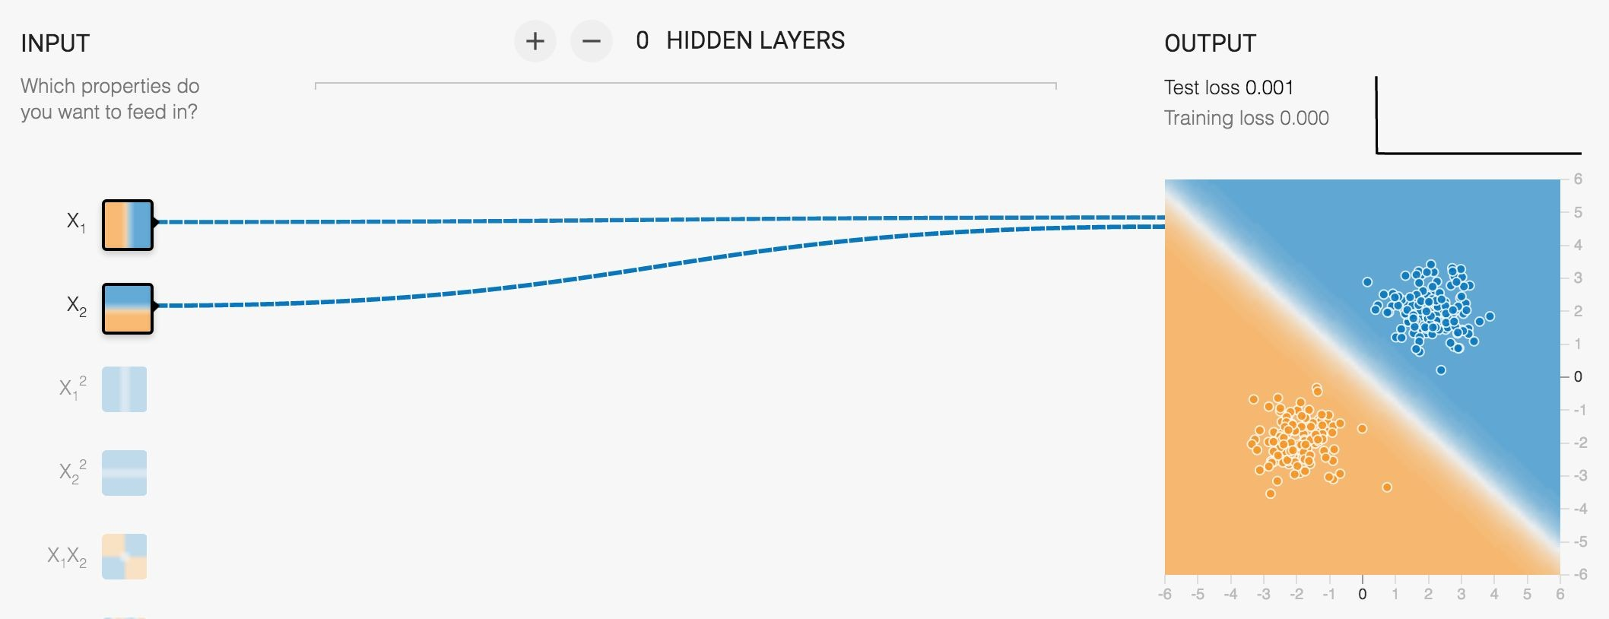
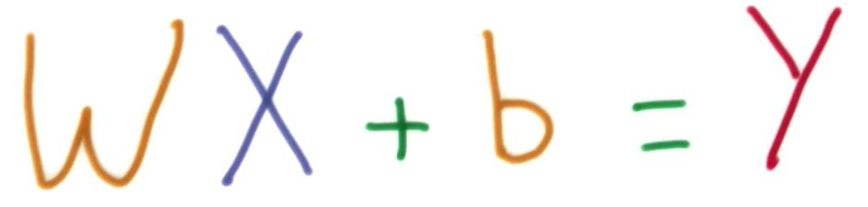
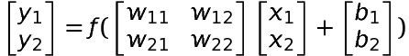
Let’s try with neural network:
The computer tries to find the best parameters

Slide 13
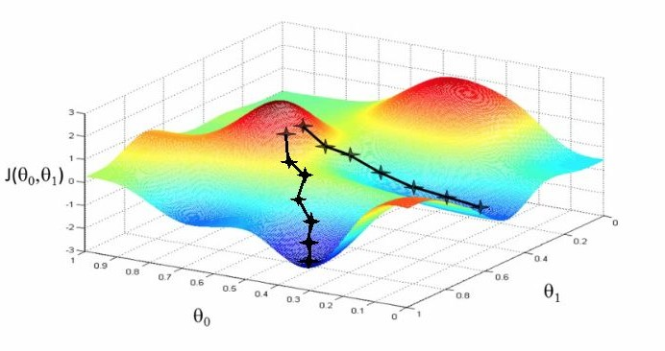
Computer tries moving the params gradually to reduce errors

Slide 14
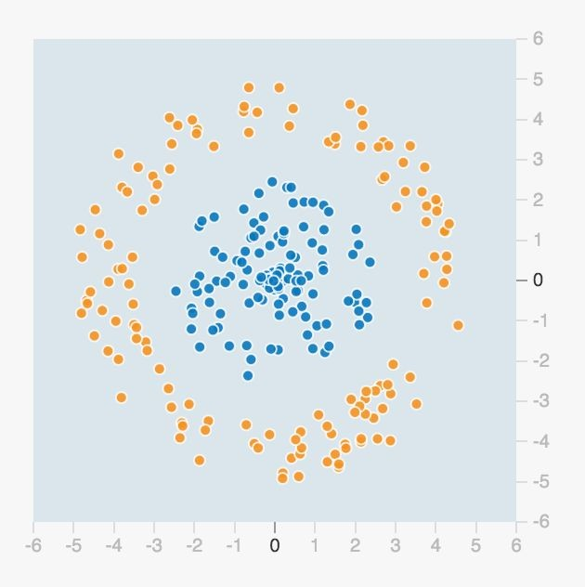
How do you classify them?

Slide 15
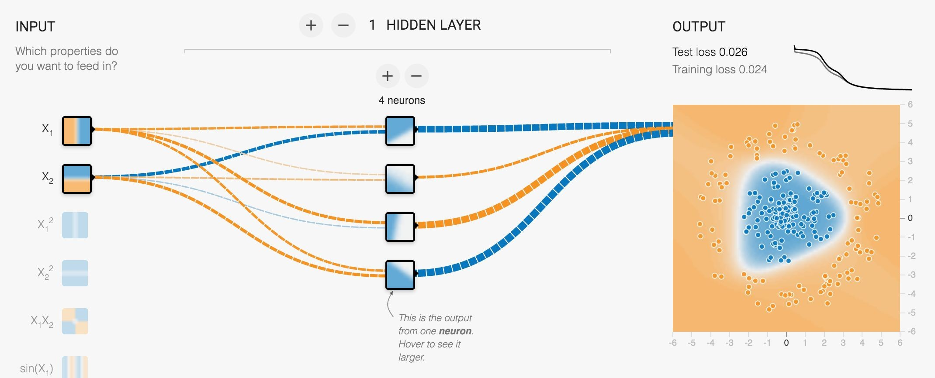
More hidden layers x neurons = More complex patterns

Slide 16
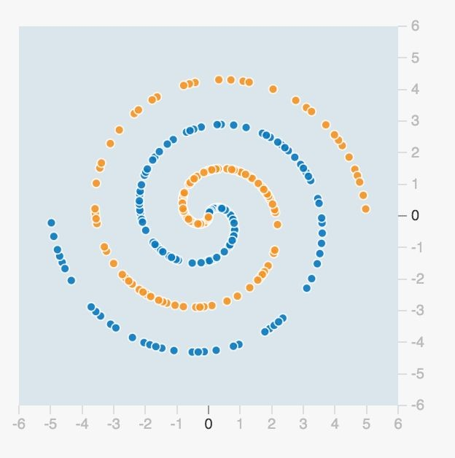
How about this?

Slide 17
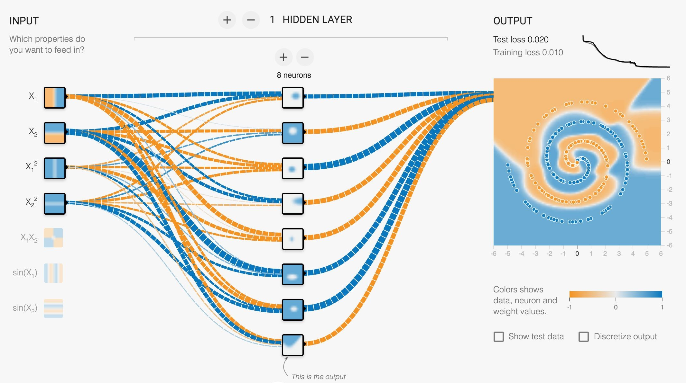

Slide 18
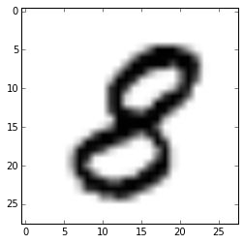
How about this?

Slide 19
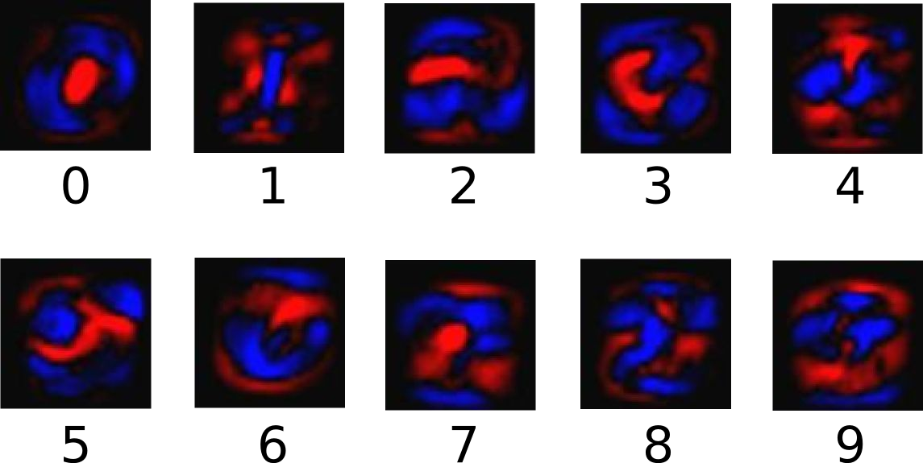


0.00 (0)
0.00 (1)
0.00 (2)
0.00 (3)
0.00 (4)
0.00 (5)
0.00 (6)
0.00 (7)
1.00 (8)
0.00 (9)
Even a single layer
can yield about 90% accuracy

Slide 20

How about this?

Slide 21
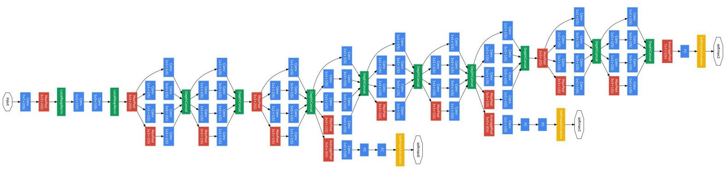
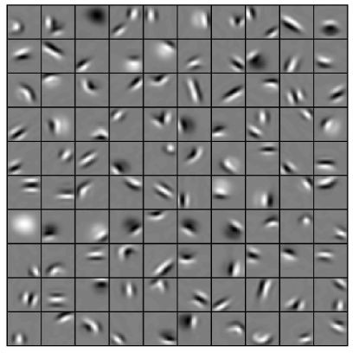
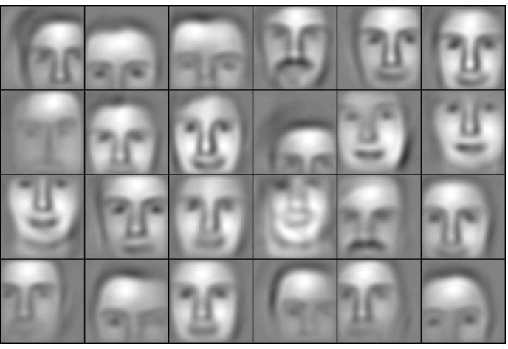
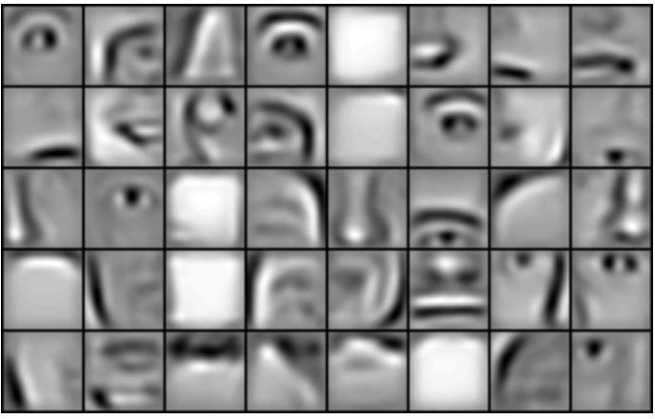
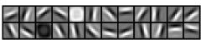



We need many more
s
From: Convolutional Deep Belief Networks for Scalable Unsupervised Learning of Hierarchical Representations, Honglak Lee et al.

Slide 22
Machine Intelligence at Google scale

Slide 23
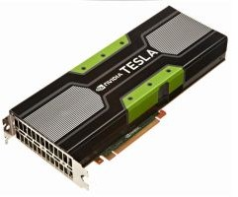
The two big challenges of Deep Learning:
Computing Power and Training Data

Slide 24
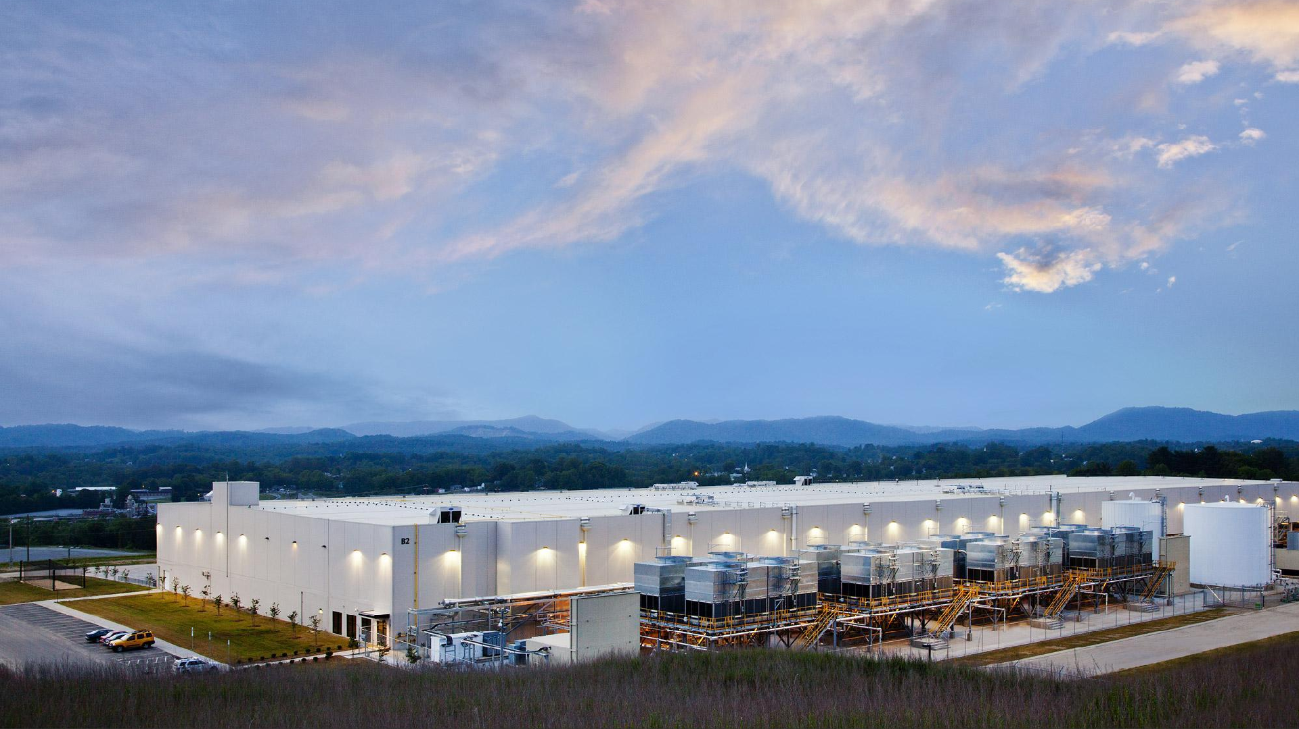

Slide 25
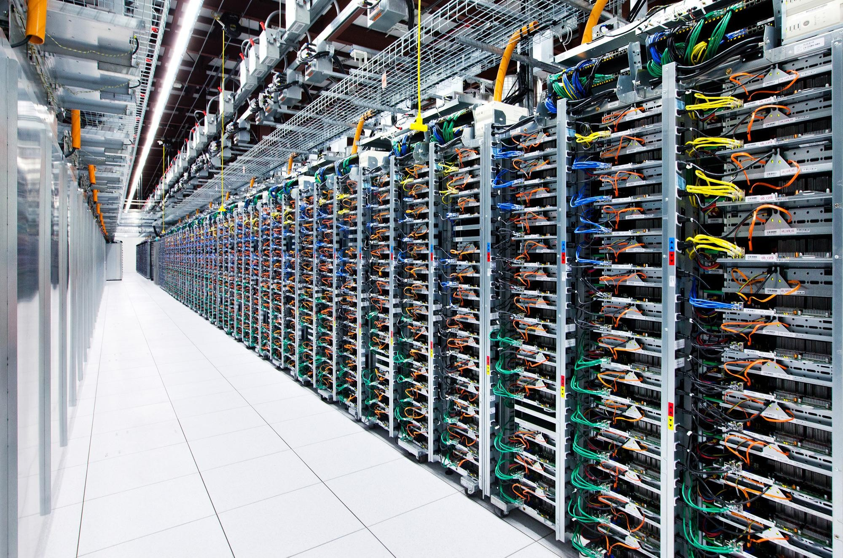
Google Cloud is
The Datacenter as a Computer
Enterprise

Slide 26
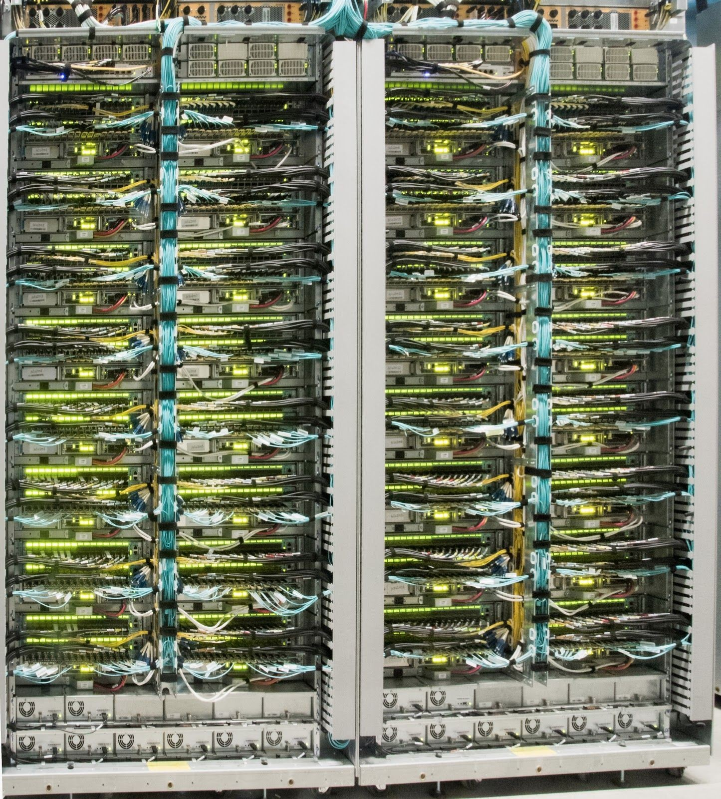
Jupiter network
10 GbE x 100 K = 1 Pbps Consolidates servers with microsec latency

Slide 27
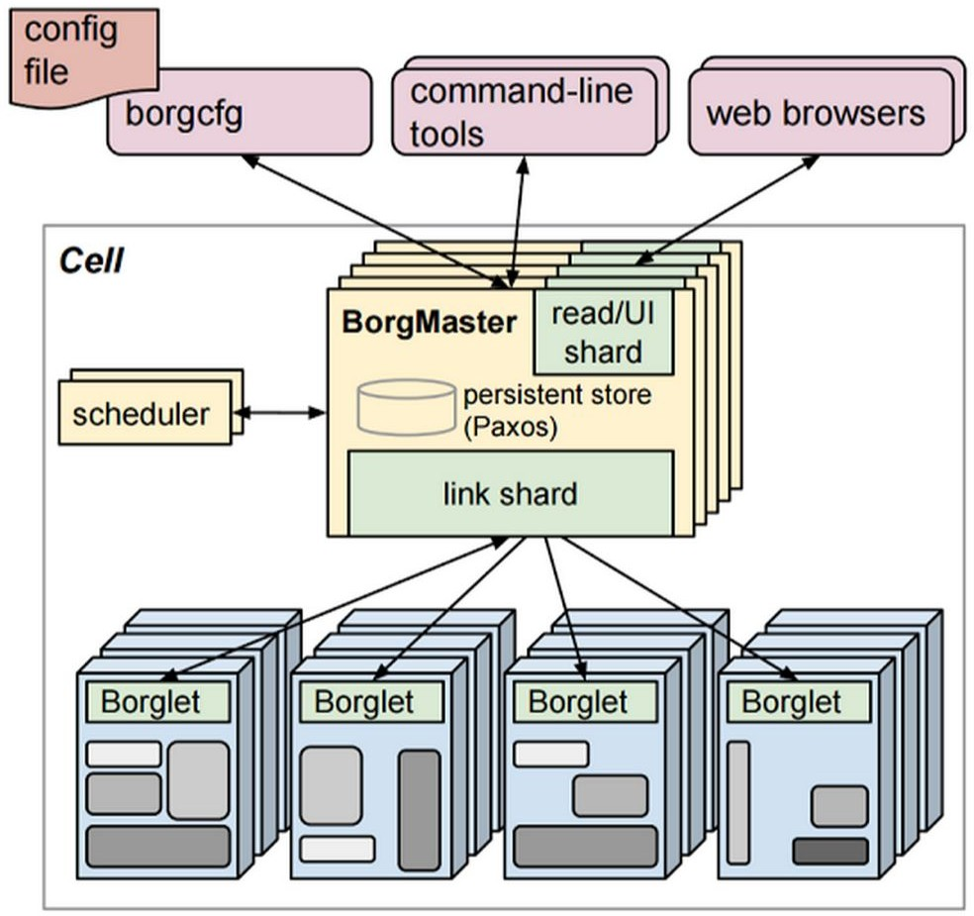
Borg
No VMs, pure containers 10K - 20K nodes per Cell DC-scale job scheduling CPUs, mem, disks and IO

Slide 28
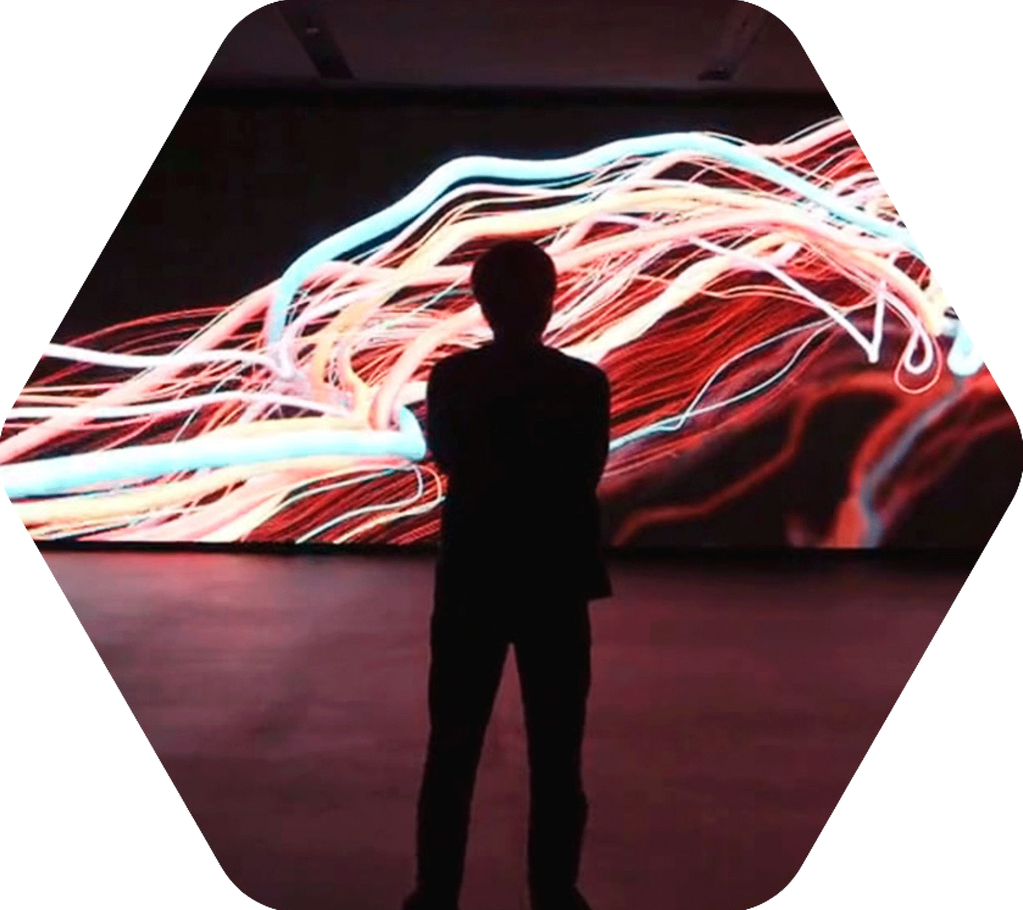
Google Cloud + Neural Network = Google Brain

Slide 29
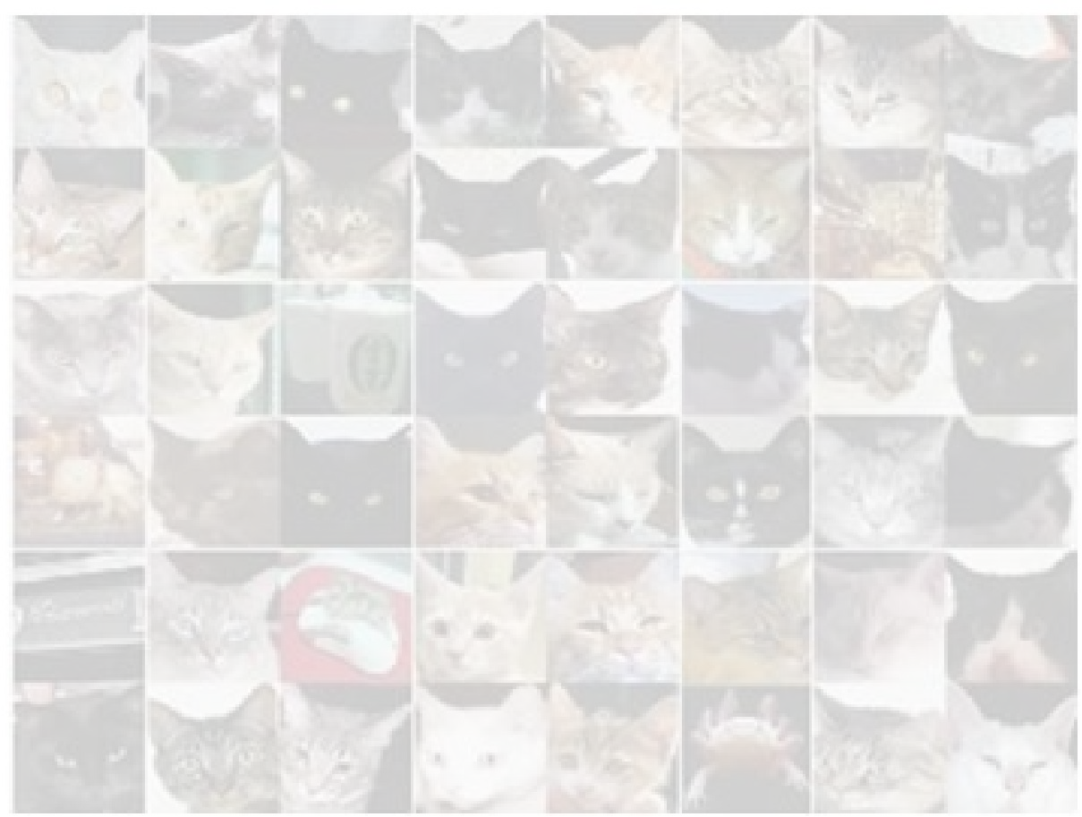
What's the scalability of Google Brain?
"Large Scale Distributed Systems for Training Neural Networks", NIPS 2015
Inception / ImageNet: 40x with 50 GPUs
RankBrain: 300x with 500 nodes

Slide 30
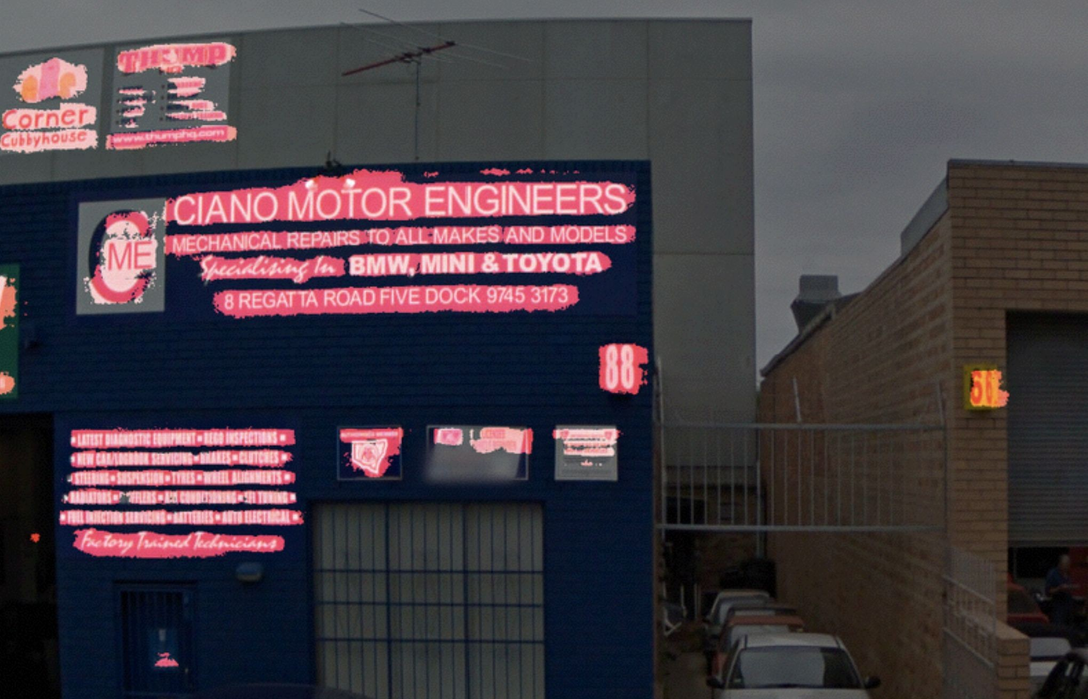
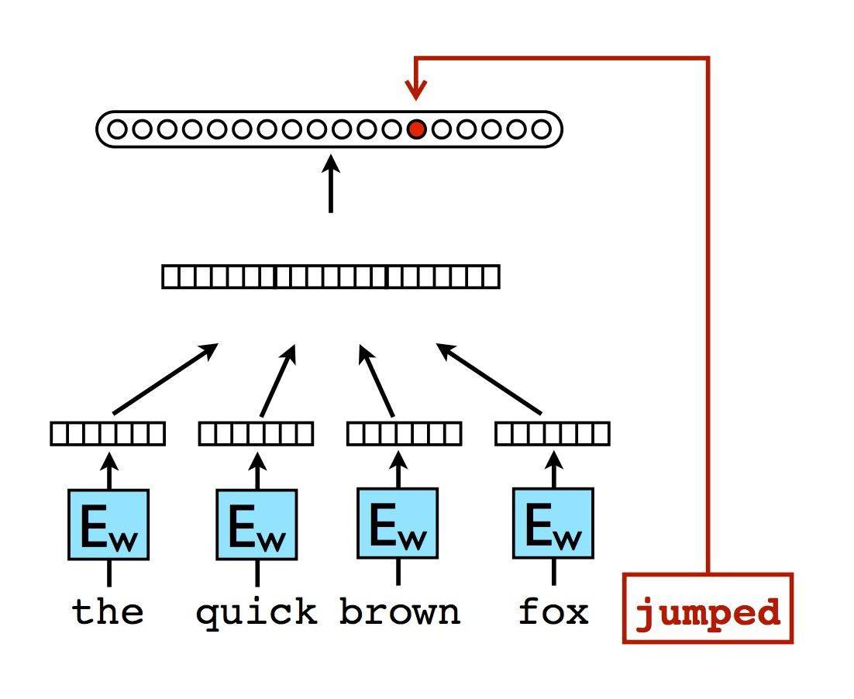
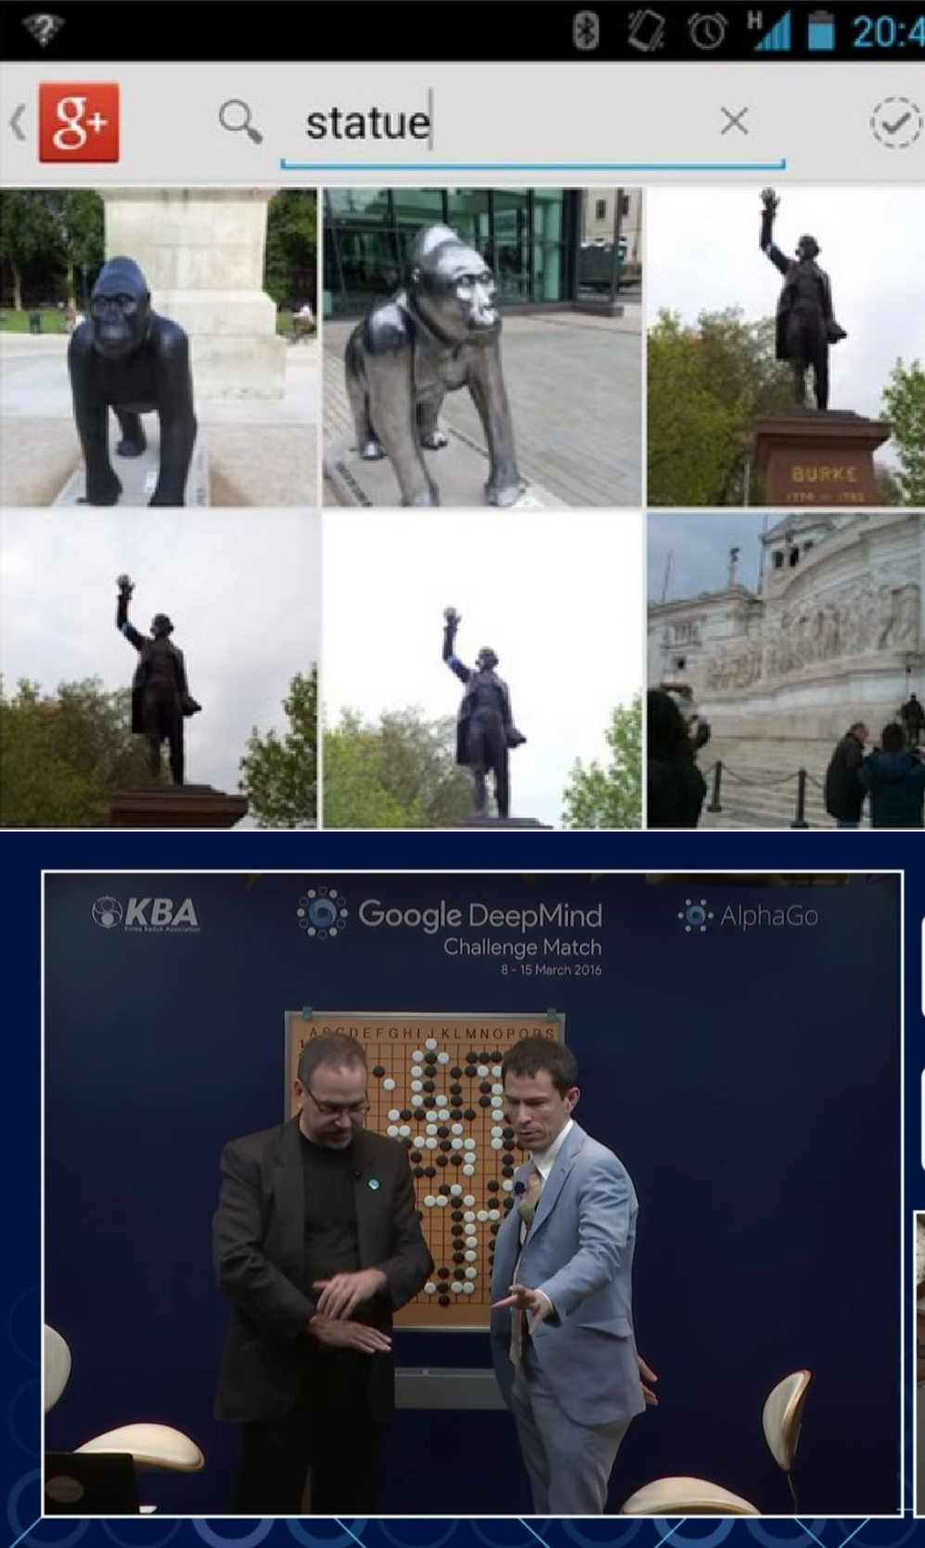
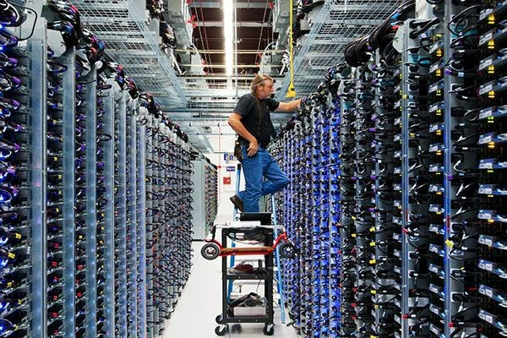


Slide 31
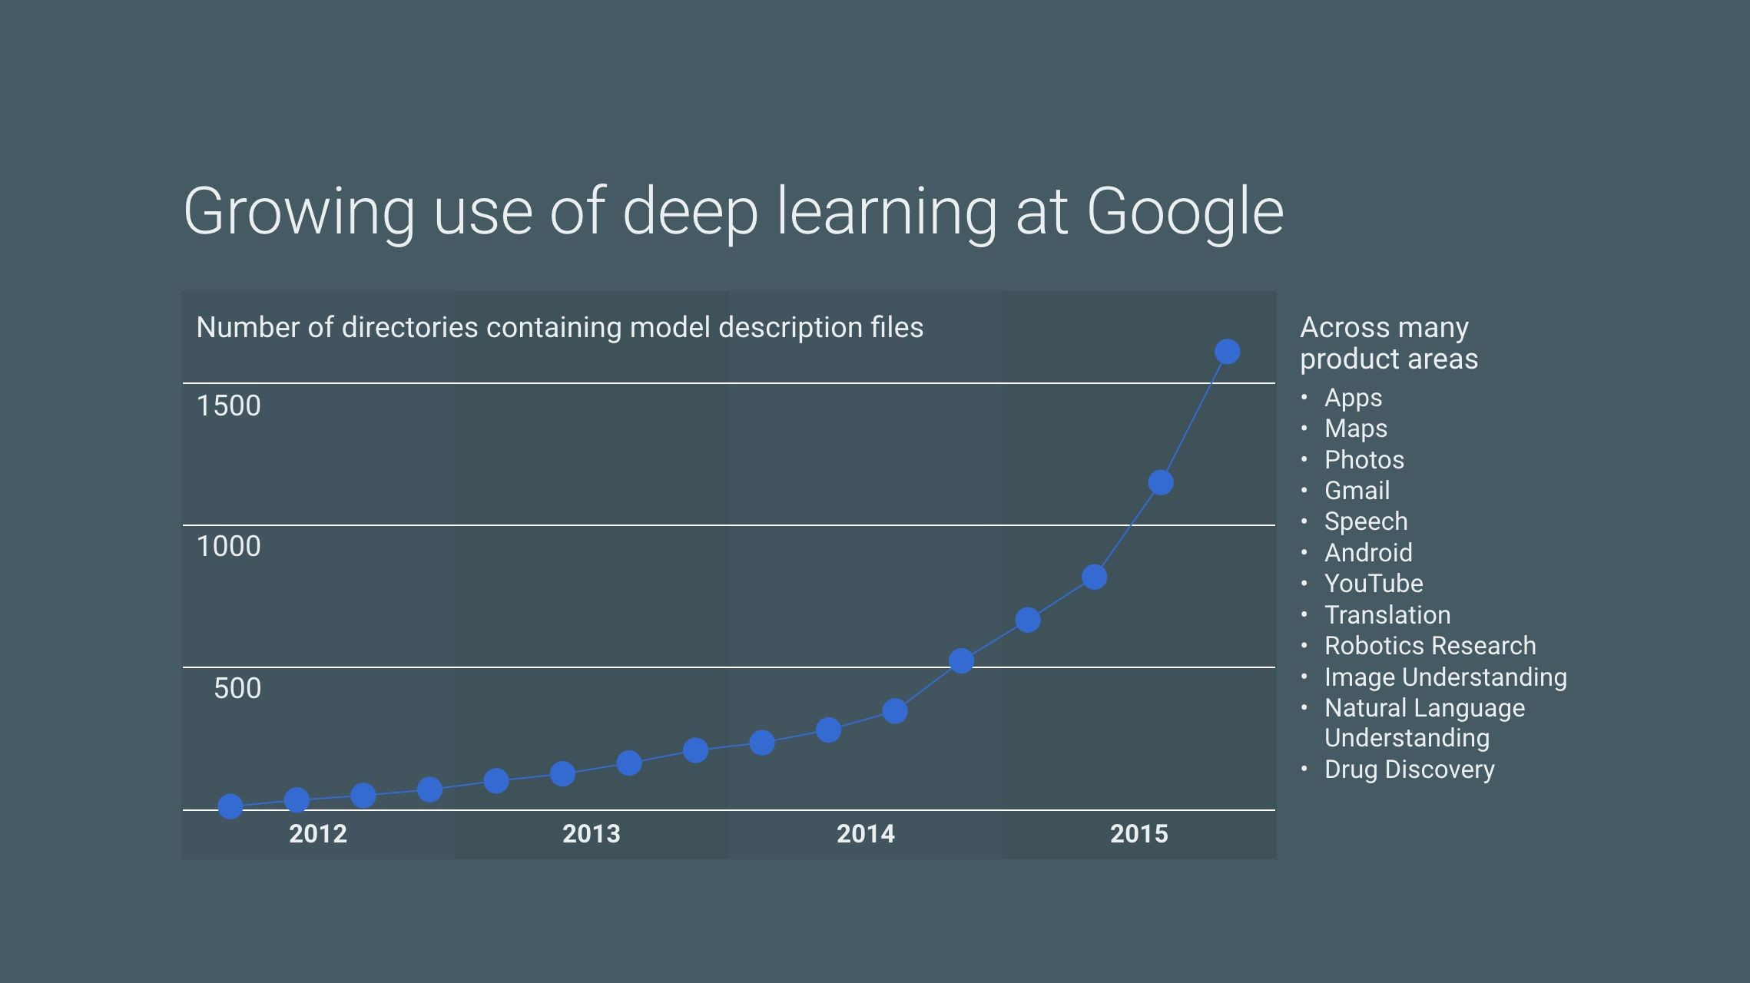
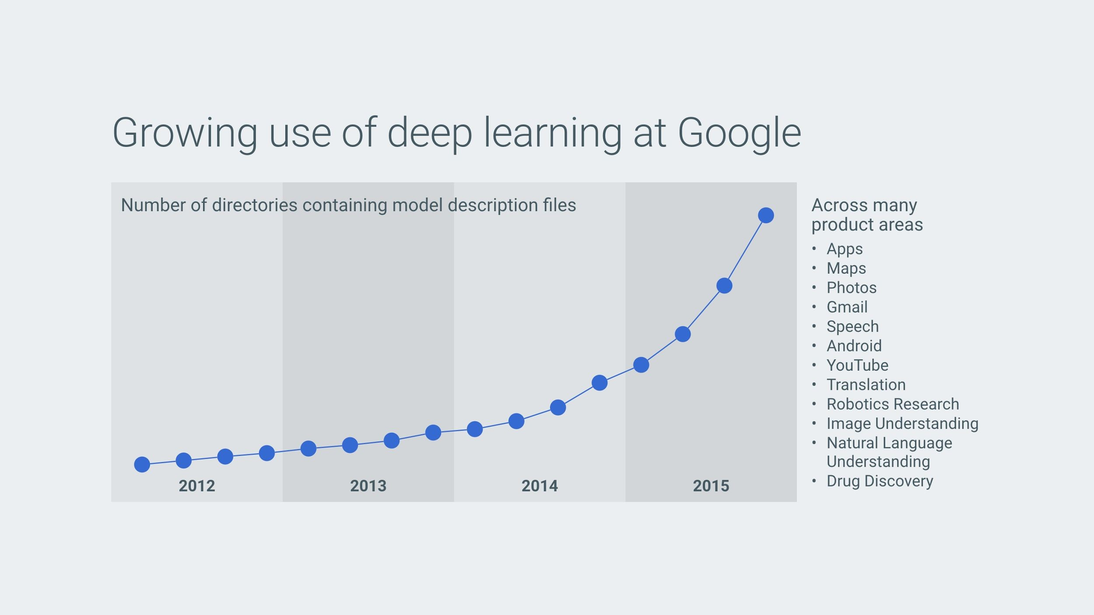
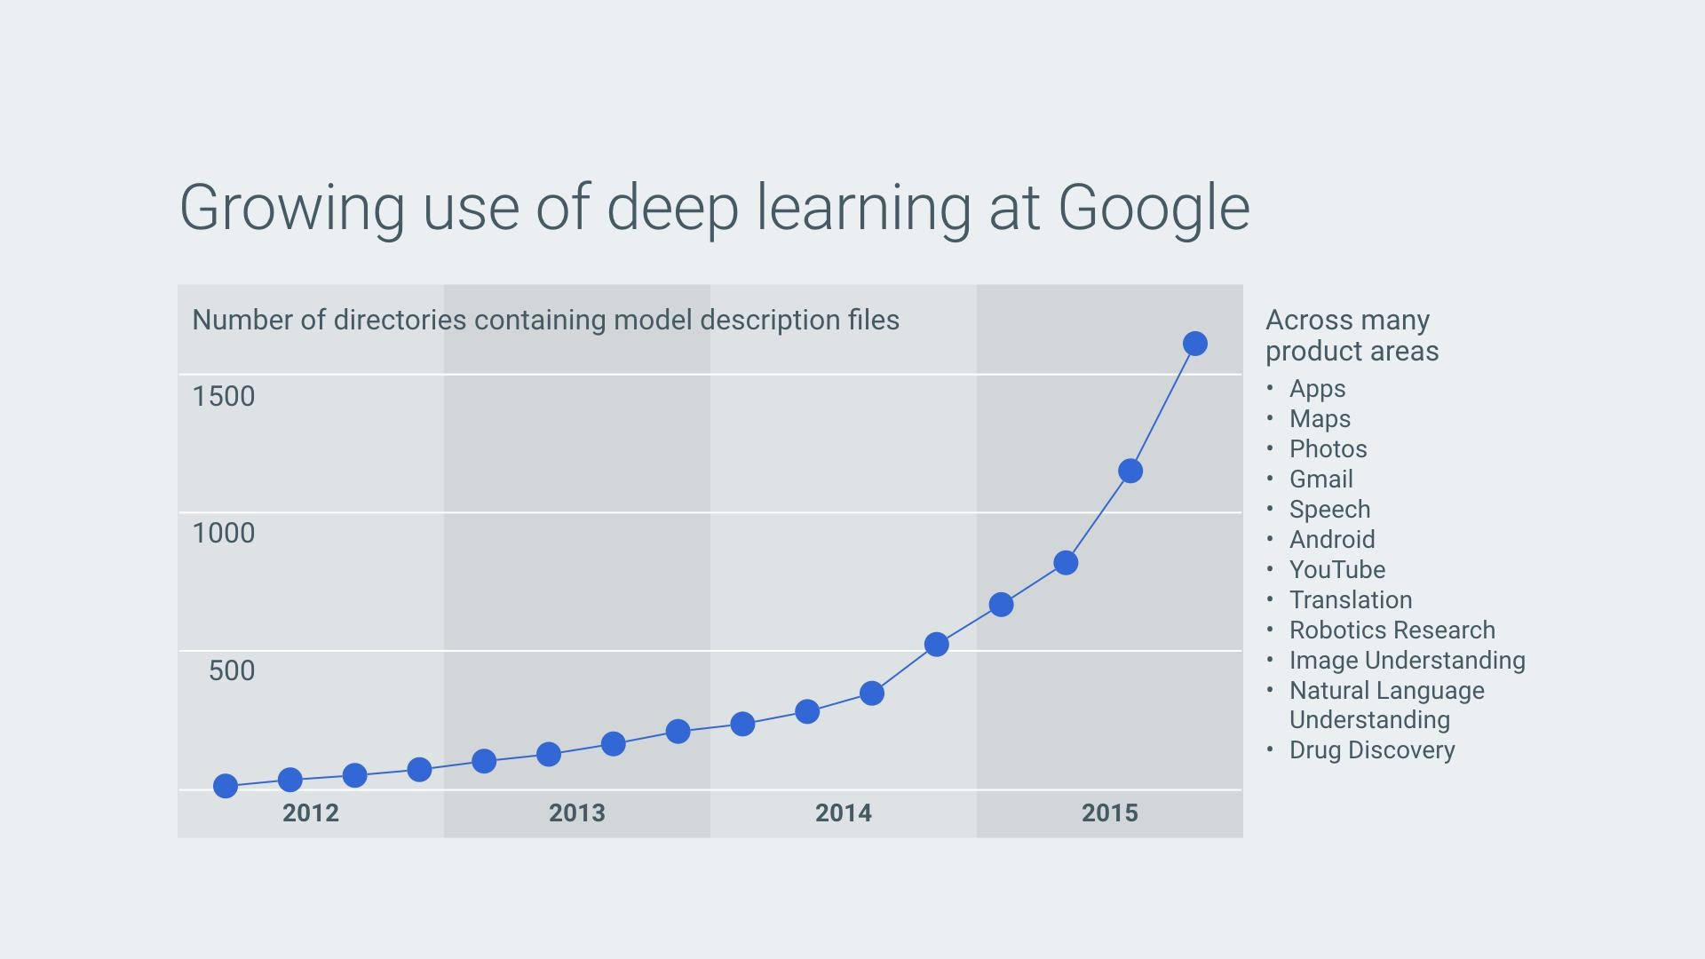
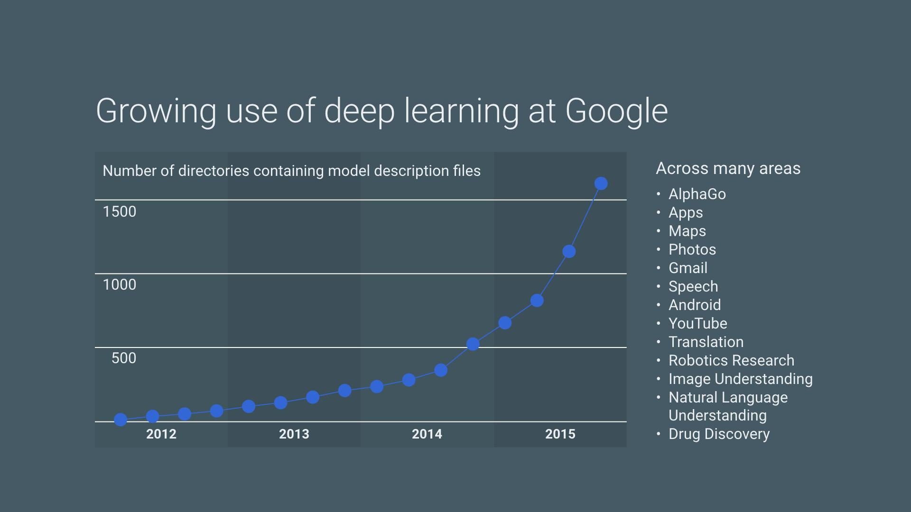

Slide 32
Externalizing the power of Brain to developers

Slide 33
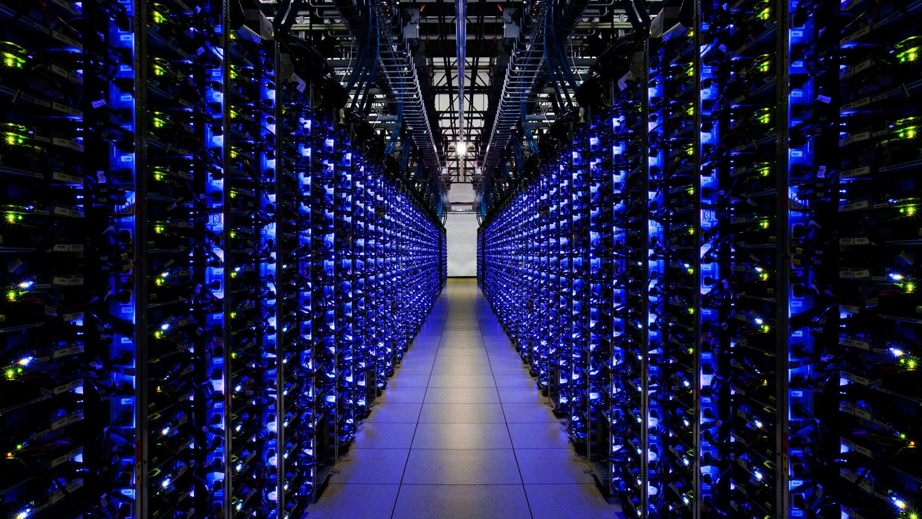




Slide 34
Cloud Vision API
Image analysis with pre-trained models
REST API: receives an image and returns a JSON No Machine Learning skill required
From $2.50 / 1,000 units (no charge* to try)
General Availability
* You will be charged for Google Cloud Storage and other Google Cloud Platform resources used in your project.

Slide 35
Projects Implemented
NASA image coloriser
Speech Recognition
Linear Regression
NLP
K-Means Clustering
Stock Prediction
Image Classification using CNN with keras

Slide 36
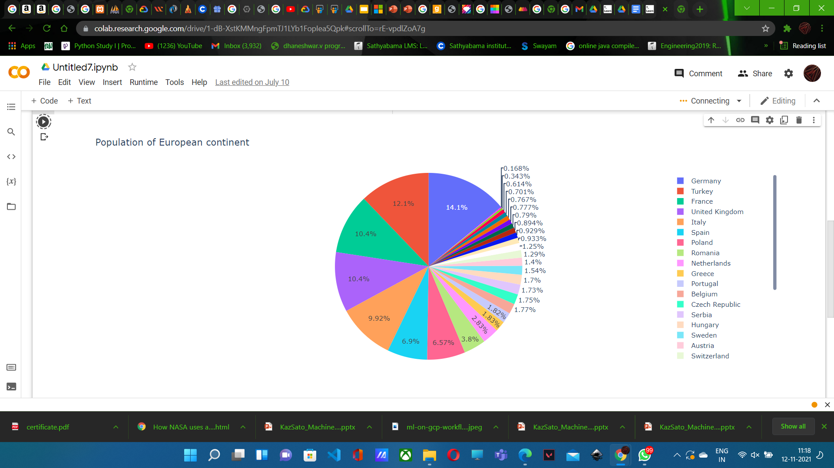
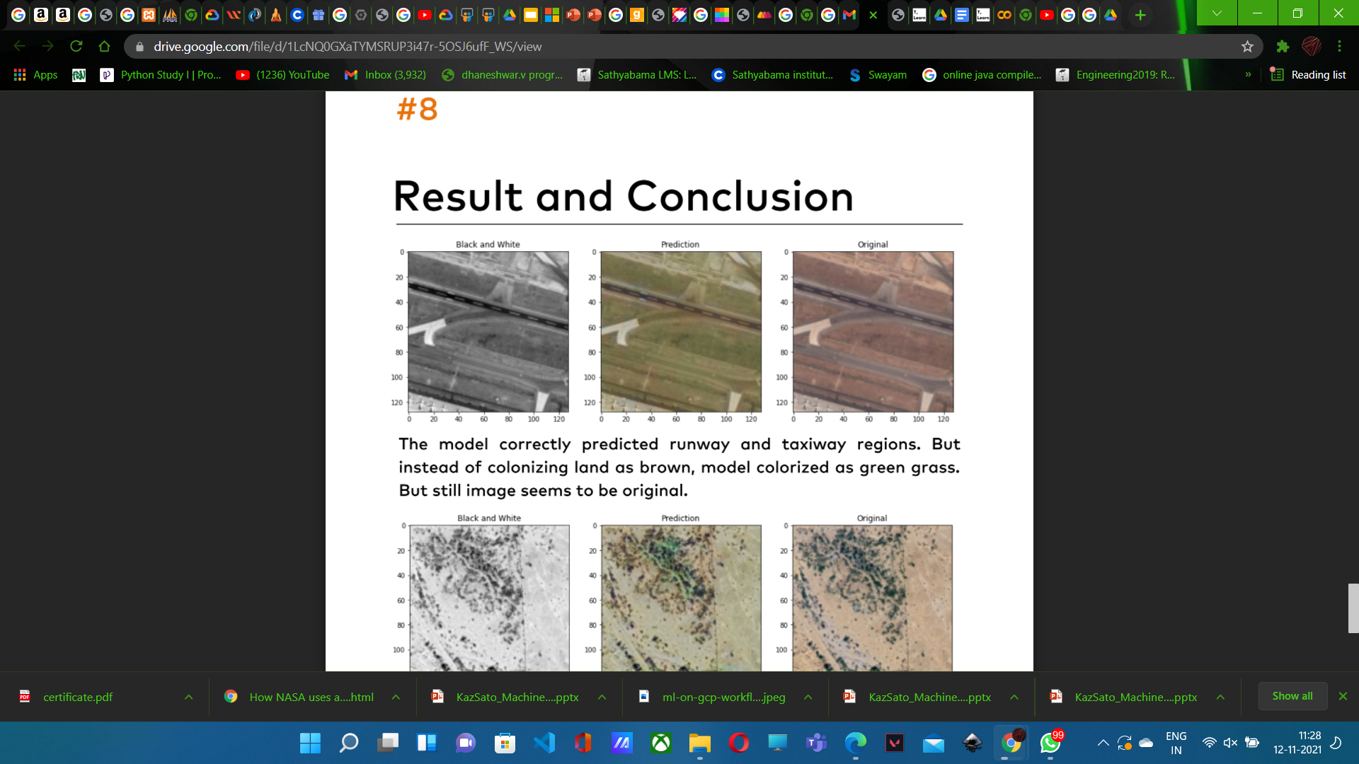
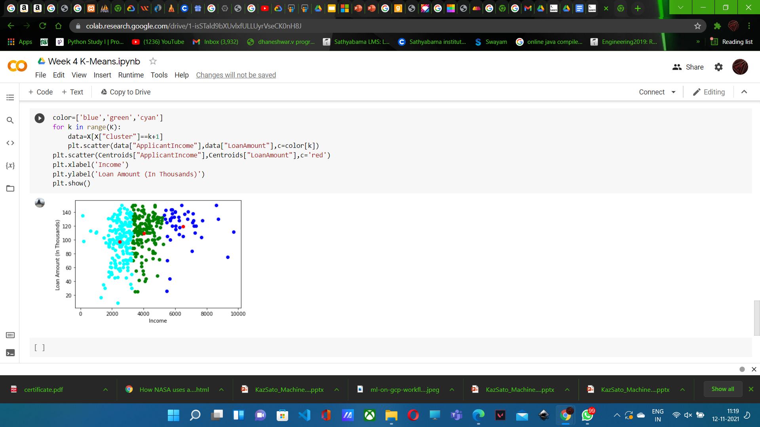
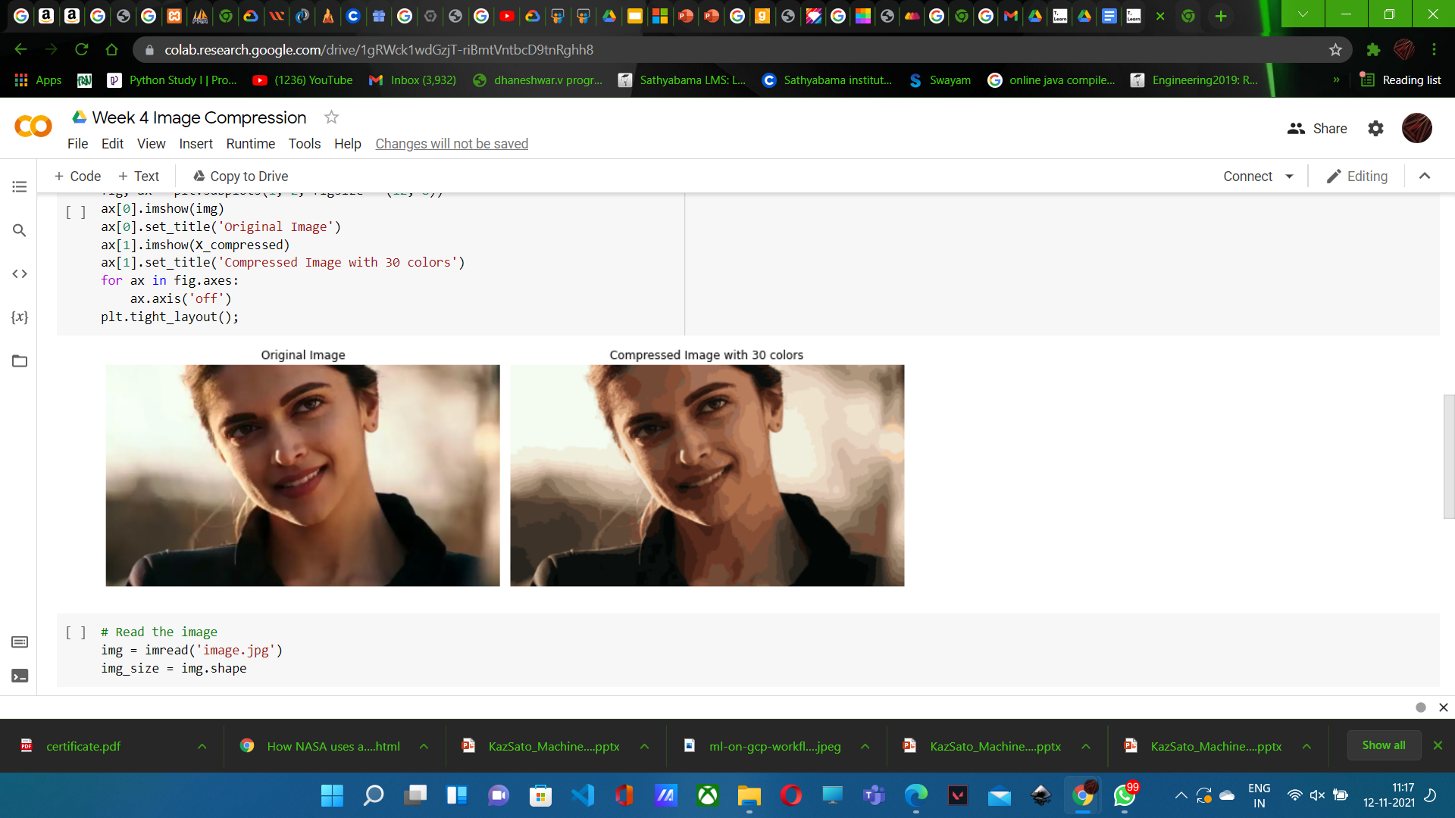
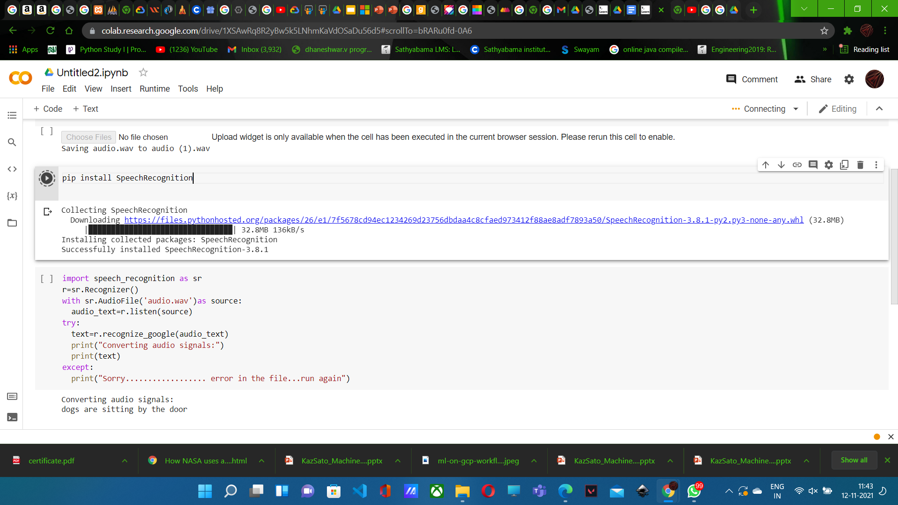
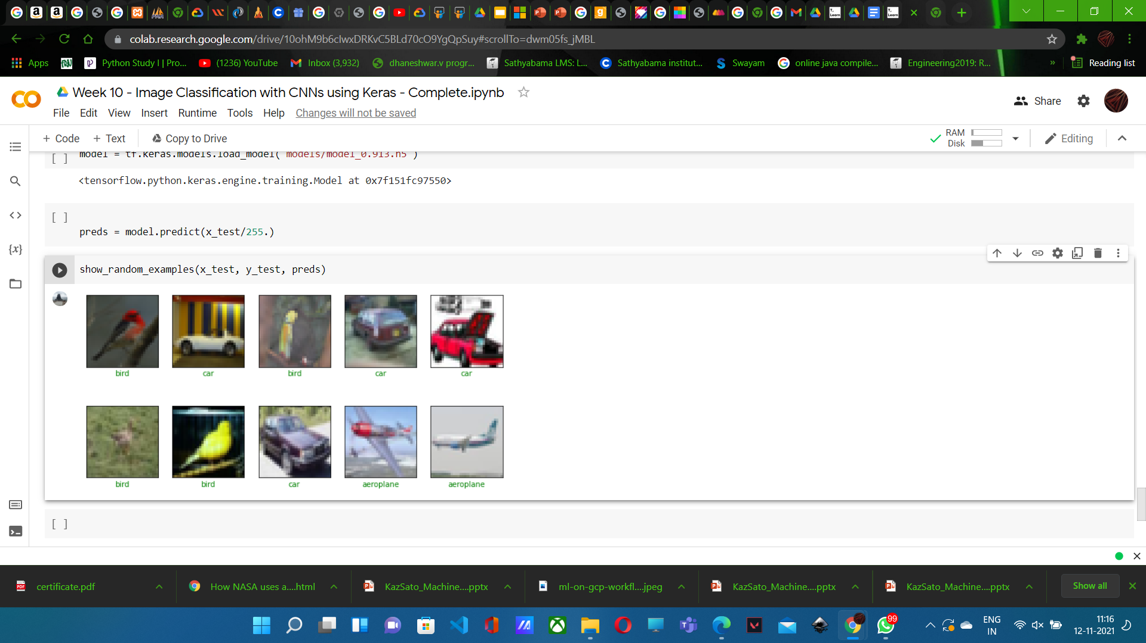
Pyplot for population of Europiens Nasa image coloriser linear Regression Image Compression Speech Recognition Image classification
Project Title

Slide 37
Demo
32

Slide 38
Cloud Speech API
Pre-trained models. No ML skill required
REST API: receives audio and returns texts Supports 80+ languages
Streaming or non-streaming
Limited Preview - cloud.google.com/speech

Slide 39
Demo
34

Slide 40
TensorFlow

Slide 41
The Machine Learning Spectrum
Industry / applications
TensorFlow
Cloud Machine Learning
Machine Learning APIs
Academic / research

Slide 42

What is TensorFlow?
Google's open source library for machine intelligence
tensorflow.org launched in Nov 2015 The second generation
Used by many production ML projects

Slide 43
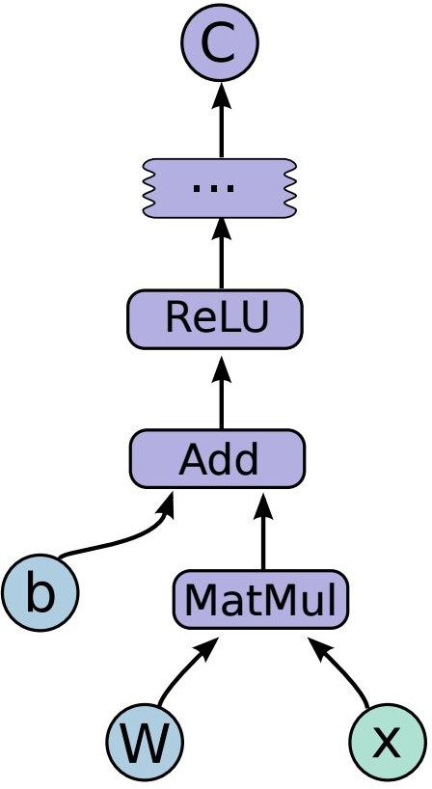
# define the network import tensorflow as tf
x = tf.placeholder(tf.float32, [None, 784]) W = tf.Variable(tf.zeros([784, 10]))
b = tf.Variable(tf.zeros([10]))
y = tf.nn.softmax(tf.matmul(x, W) + b)
# define a training step
y_ = tf.placeholder(tf.float32, [None, 10]) xent = -tf.reduce_sum(y_*tf.log(y))
step = tf.train.GradientDescentOptimizer(0.01).minimize (xent)

Slide 44
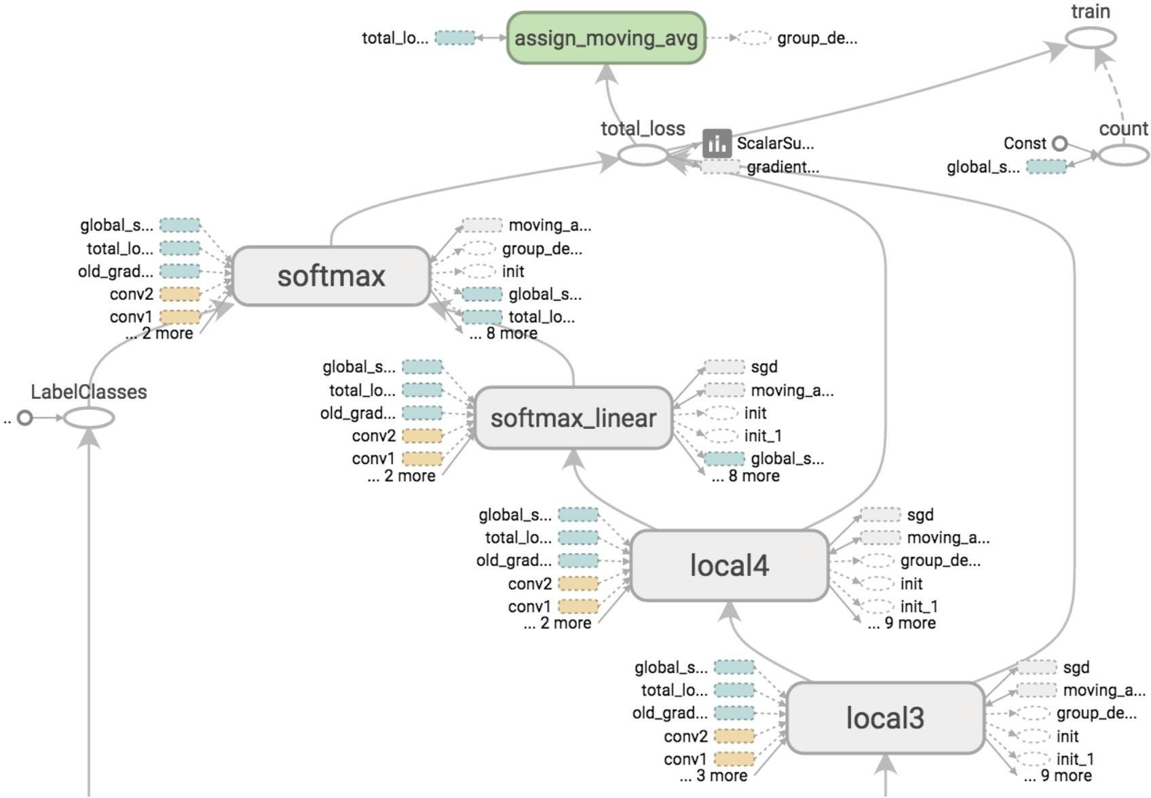
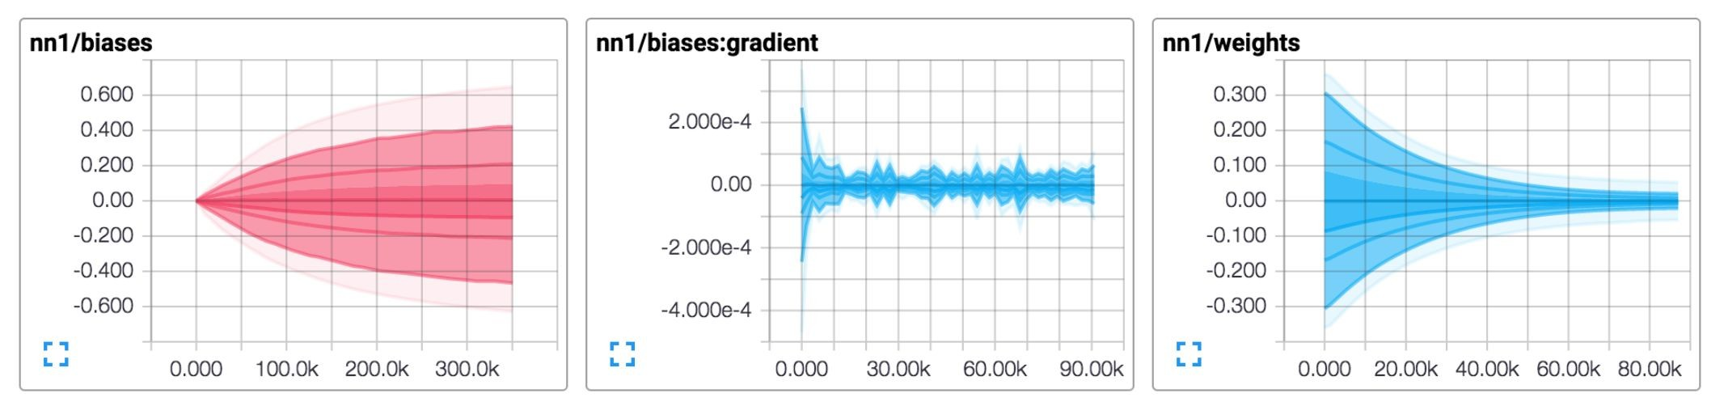
TensorBoard: visualization tool

Slide 45
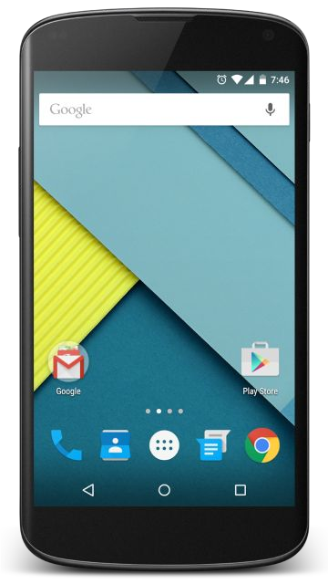
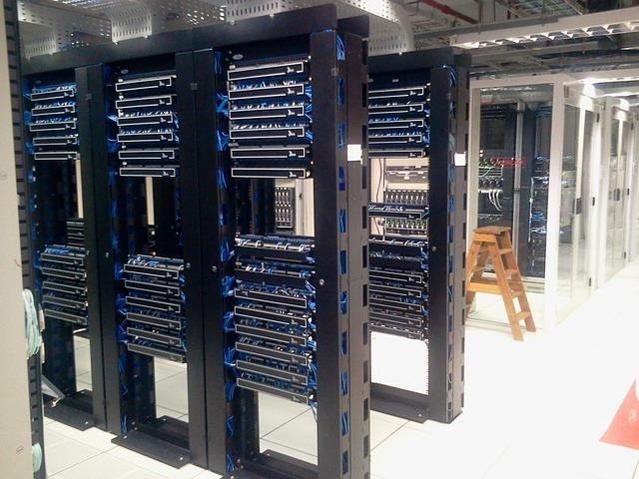
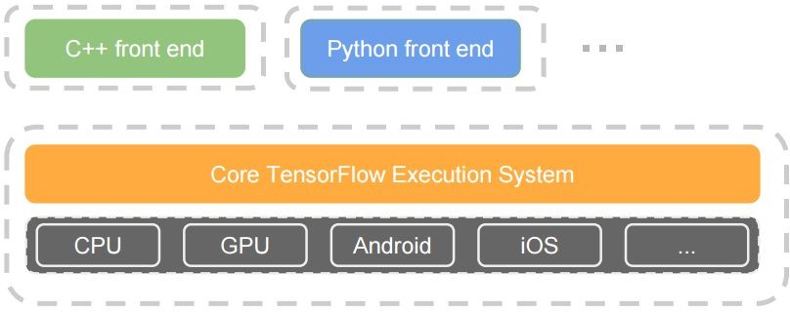
Portable
Training on:
Data Center
CPUs, GPUs and etc
Running on:
Mobile phones
IoT devices

Slide 46

Tensor Processing Unit
ASIC for TensorFlow Designed by Google 10x better perf / watt latency and efficiency bit quantization

Slide 47

RankBrain AlphaGo Google Photos Speech

Slide 48

Cloud Machine Learning (Cloud ML)
Fully managed, distributed training and prediction
for custom TensorFlow graph
Supports Regression and Classification initially Integrated with Cloud Dataflow and Cloud Datalab Limited Preview - cloud.google.com/ml

Slide 49
Cloud ML demo
Jeff Dean's keynote: YouTube video
Define a custom TensorFlow graph Training at local: 8.3 hours w/ 1 node
Training at cloud: 32 min w/ 20 nodes (15x faster) Prediction at cloud at 300 reqs / sec

Slide 50
System Requirement & Tool Used
Kaggle: For Datasets
Cloud: Google Cloud Platform,google Data lab
Editor: Google Colab
Space:100gb space in Google Colab,Open source
Packages:NumPy,matplotlib,Speech Recognition,
Keras,nlp,seaborn,plotly,pandas
Data Visualisation package: Matplotlib, NumPy,
Pandas
Pip :Latest Version
Datalab: Free for 90 days,Easy to deploy

Slide 51
Links & Resources
Large Scale Distributed Systems for Training Neural Networks, Jeff Dean and Oriol Vinals
GitHub Account for Review projects: https://github.com/dhaneshwar2310/projectML
Cloud Vision API: cloud.google.com/vision Cloud Speech API: cloud.google.com/speech TensorFlow: tensorflow.org
Cloud Machine Learning: cloud.google.com/ml Cloud Machine Learning: demo video
Nasa image Colorisier:https://docs.google.com/document/d/1NxARLJrRDwhEng9zw01UF3REuwbtTCoTJey4x6Jj8NQ/edit?usp=sharing

Slide 52
Thank you!

